Slide 1
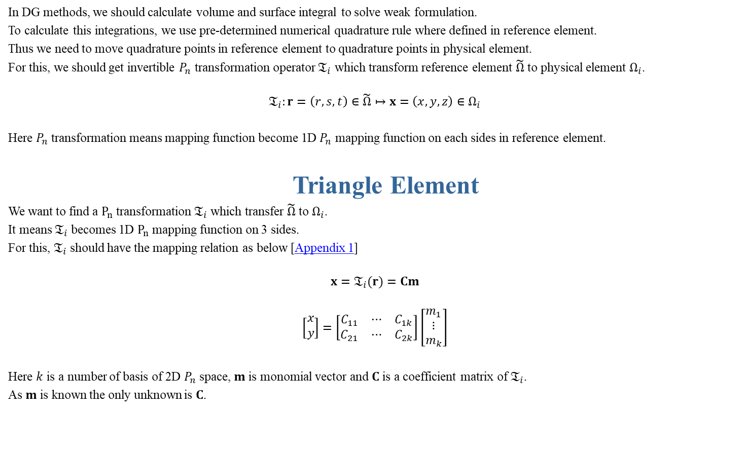
In DG methods, we should calculate volume and surface integral to solve weak formulation.
To calculate this integrations, we use pre-determined numerical quadrature rule where defined in reference element.
Thus we need to move quadrature points in reference element to quadrature points in physical element.
For this, we should get invertible $P_{n}$ transformation operator $𝔗_{i}$ which transform reference element $\tilde{Ω}$ to physical element $Ω_{i}$.
$$𝔗_{i}:r=\left(r,s,t\right)∈\tilde{Ω}↦x=\left(x,y,z\right)∈Ω_{i}$$
Here $P_{n}$ transformation means mapping function become 1D $P_{n}$ mapping function on each sides in reference element.
Triangle Element
We want to find a $P_{n}$ transformation $𝔗_{i}$ which transfer $\tilde{Ω}$ to $Ω_{i}$.
It means $𝔗_{i}$ becomes 1D $P_{n}$ mapping function on 3 sides.
For this, $𝔗_{i}$ should have the mapping relation as below [Appendix 1]
$$x=𝔗_{i}(r)=Cm$$
$$\left[\begin{aligned}x \\ y\end{aligned}\right]=\left[\begin{aligned}\begin{matrix}C_{11} & ⋯ & C_{1k}\end{matrix} \\ \begin{matrix}C_{21} & ⋯ & C_{2k}\end{matrix}\end{aligned}\right]\left[\begin{aligned}m_{1} \\ ⋮ \\ m_{k}\end{aligned}\right]$$
Here $k$ is a number of basis of 2D $P_{n}$ space, $m$ is monomial vector and $C$ is a coefficient matrix of $𝔗_{i}$.
As $m$ is known the only unknown is $C$.

Slide 2
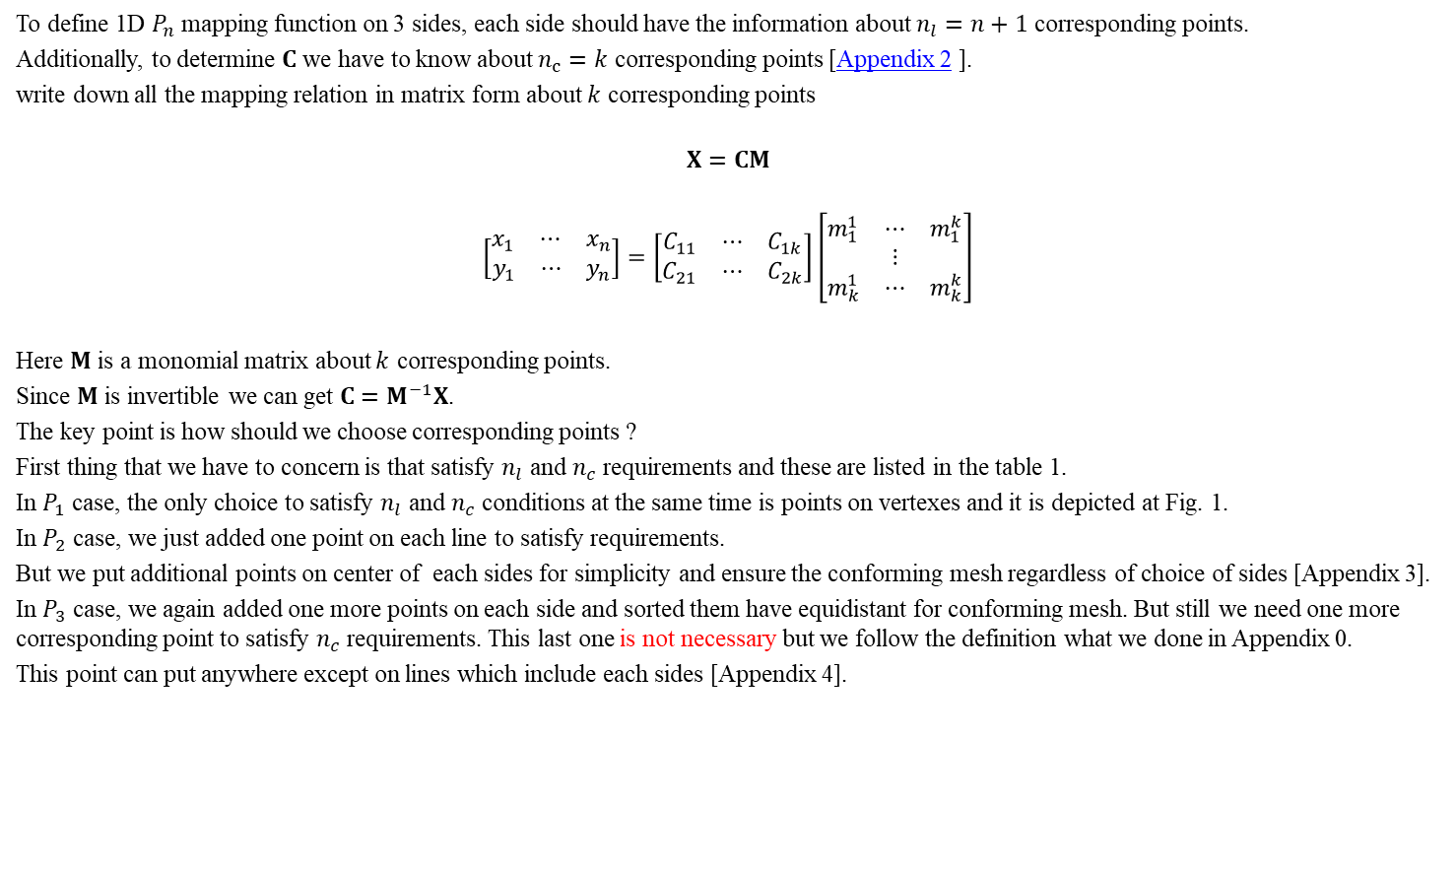
To define 1D $P_{n}$ mapping function on 3 sides, each side should have the information about $n_{l}=n+1$ corresponding points.
Additionally, to determine $C$ we have to know about $n_{c}=k$ corresponding points [Appendix 2 ].
write down all the mapping relation in matrix form about $k$ corresponding points
$$X=CM$$
$$\left[\begin{aligned}\begin{matrix}x_{1} & ⋯ & x_{n}\end{matrix} \\ \begin{matrix}y_{1} & ⋯ & y_{n}\end{matrix}\end{aligned}\right]=\left[\begin{aligned}\begin{matrix}C_{11} & ⋯ & C_{1k}\end{matrix} \\ \begin{matrix}C_{21} & ⋯ & C_{2k}\end{matrix}\end{aligned}\right]\left[\begin{aligned}\begin{matrix}m_{1}^{1} & ⋯ & m_{1}^{k}\end{matrix} \\ ⋮ \\ \begin{matrix}m_{k}^{1} & ⋯ & m_{k}^{k}\end{matrix}\end{aligned}\right]$$
Here $M$ is a monomial matrix about $k$ corresponding points.
Since $M$ is invertible we can get $C=M^{−1}X$.
The key point is how should we choose corresponding points ?
First thing that we have to concern is that satisfy $n_{l}$ and $n_{c}$ requirements and these are listed in the table 1.
In $P_{1}$ case, the only choice to satisfy $n_{l}$ and $n_{c}$ conditions at the same time is points on vertexes and it is depicted at Fig. 1.
In $P_{2}$ case, we just added one point on each line to satisfy requirements.
But we put additional points on center of each sides for simplicity and ensure the conforming mesh regardless of choice of sides [Appendix 3].
In $P_{3}$ case, we again added one more points on each side and sorted them have equidistant for conforming mesh. But still we need one more corresponding point to satisfy $n_{c}$ requirements. This last one is not necessary but we follow the definition what we done in Appendix 0.
This point can put anywhere except on lines which include each sides [Appendix 4].

Slide 3
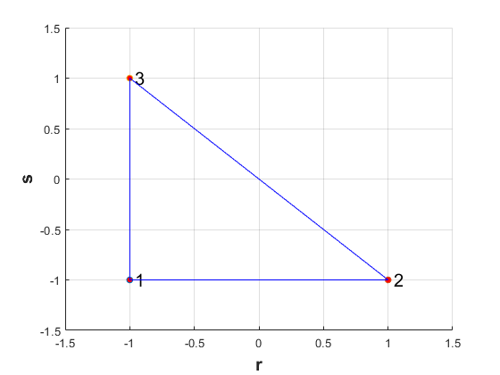
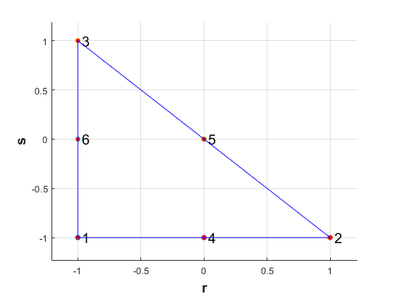
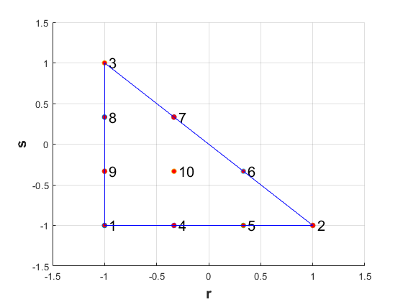
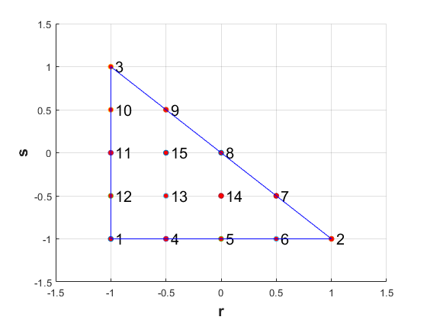
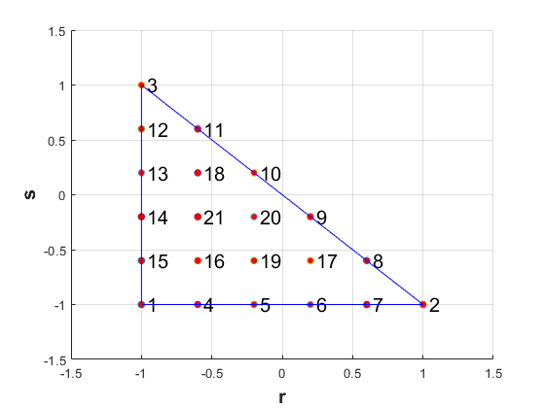
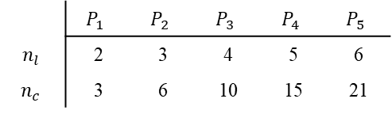
 | $$P_{1}$$ | $$P_{2}$$ | $$P_{3}$$ | $$P_{4}$$ | $$P_{5}$$
$$n_{l}$$ | 2 | 3 | 4 | 5 | 6
$$n_{c}$$ | 3 | 6 | 10 | 15 | 21

Slide 4

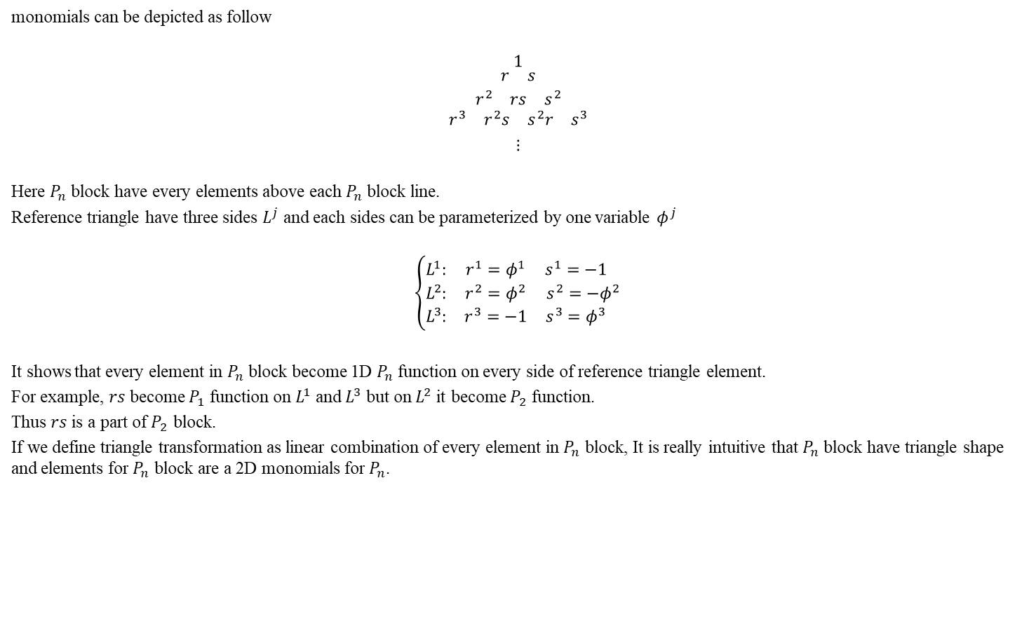


Appendix 0
monomials can be depicted as follow
$$\begin{matrix}1 \\ \begin{aligned}\begin{aligned}\begin{matrix}r & s\end{matrix} \\ \begin{matrix}r^{2} & rs & s^{2}\end{matrix} \\ \begin{matrix}\begin{matrix}r^{3} & r^{2}s\end{matrix} & \begin{matrix}s^{2}r & s^{3}\end{matrix}\end{matrix}\end{aligned} \\ \\ ⋮\end{aligned}\end{matrix}$$
Here $P_{n}$ block have every elements above each $P_{n}$ block line.
Reference triangle have three sides $L^{j}$ and each sides can be parameterized by one variable $φ^{j}$
$$\left\{\begin{matrix}L^{1}: & r^{1}=φ^{1} & s^{1}=−1 \\ L^{2}: & r^{2}=φ^{2} & s^{2}=−φ^{2} \\ L^{3}: & r^{3}=−1 & s^{3}=φ^{3} \end{matrix}\right.$$
It shows that every element in $P_{n}$ block become 1D $P_{n}$ function on every side of reference triangle element.
For example, $rs$ become $P_{1}$ function on $L^{1}$ and $L^{3}$ but on $L^{2}$ it become $P_{2}$ function.
Thus $rs$ is a part of $P_{2}$ block.
If we define triangle transformation as linear combination of every element in $P_{n}$ block, It is really intuitive that $P_{n}$ block have triangle shape and elements for $P_{n}$ block are a 2D monomials for $P_{n}$.
$$P_{1} block line$$
$$P_{2} block line$$
$$P_{3} block line$$

Slide 5

Appendix 1
We want to know how to express $𝔗_{i}$.
Suppose that $𝔗_{i}$ is consists of monomials $m={\left[m_{1},m_{2},m_{3},m_{4},m_{5},m_{6}⋯\right]}^{T}={\left[1,r,s,r^{2},rs,s^{2},⋯\right]}^{T}$.
Then the mapping relation can write down in matrix form
$$x=𝔗_{i}(r)=m^{T}C$$
$$\left[\begin{matrix}x & y\end{matrix}\right]=\left[\begin{matrix}m_{1}(r) & ⋯ & \end{matrix}\right]\left[\begin{matrix}\begin{aligned}c_{11} \\ ⋮ \\ \end{aligned} & \begin{aligned}c_{12} \\ ⋮ \\ \end{aligned}\end{matrix}\right]$$
To have 1D $P_{n}$ mapping function on every sides, consisting monomial of $𝔗_{i}$ for $P_{n}$ is 2D $P_{n}$ monomials [Appendix 0].
Therefore we can rewrite $𝔗_{i}$ for $P_{n}$
$$\left[\begin{matrix}x & y\end{matrix}\right]=\left[\begin{matrix}m_{1}(r) & ⋯ & m_{k}(r)\end{matrix}\right]\left[\begin{matrix}\begin{aligned}c_{11} \\ ⋮ \\ c_{k1}\end{aligned} & \begin{aligned}c_{12} \\ ⋮ \\ c_{k2}\end{aligned}\end{matrix}\right]$$
Here $k= _{n+2}C_{2}=\frac{\left(n+1\right)\left(n+2\right)}{2}$ is the number of basis of 2D $P_{n}$ space.

Slide 6
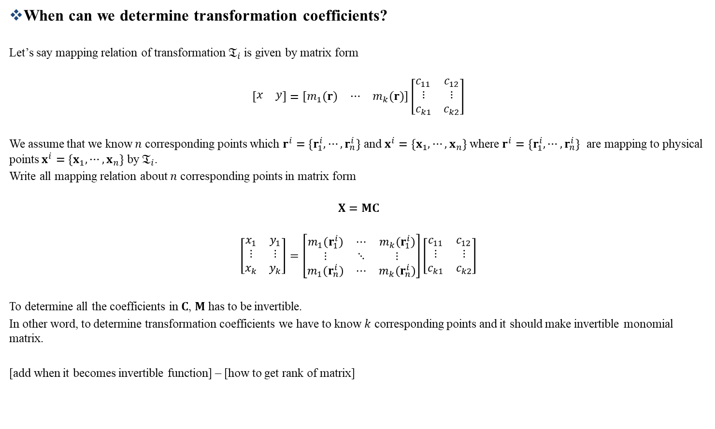
Appendix 2
When can we determine transformation coefficients?
Let’s say mapping relation of transformation $𝔗_{i}$ is given by matrix form
$$\left[\begin{matrix}x & y\end{matrix}\right]=\left[\begin{matrix}m_{1}(r) & ⋯ & m_{k}(r)\end{matrix}\right]\left[\begin{matrix}\begin{aligned}c_{11} \\ ⋮ \\ c_{k1}\end{aligned} & \begin{aligned}c_{12} \\ ⋮ \\ c_{k2}\end{aligned}\end{matrix}\right]$$
We assume that we know $n$ corresponding points which $r^{i}=\{r_{1}^{i},⋯,r_{n}^{i}\}$ and $x^{i}=\{x_{1},⋯,x_{n}\}$ where $r^{i}=\{r_{1}^{i},⋯,r_{n}^{i}\}$ are mapping to physical points $x^{i}=\{x_{1},⋯,x_{n}\}$ by $𝔗_{i}$.
Write all mapping relation about $n$ corresponding points in matrix form
$$X=MC$$
$$\left[\begin{matrix}x_{1} & y_{1} \\ ⋮ & ⋮ \\ x_{k} & y_{k}\end{matrix}\right]=\left[\begin{matrix}m_{1}(r_{1}^{i}) & ⋯ & m_{k}(r_{1}^{i}) \\ ⋮ & ⋱ & ⋮ \\ m_{1}(r_{n}^{i}) & ⋯ & m_{k}(r_{n}^{i})\end{matrix}\right]\left[\begin{matrix}c_{11} & c_{12} \\ ⋮ & ⋮ \\ c_{k1} & c_{k2}\end{matrix}\right]$$
To determine all the coefficients in $C$, $M$ has to be invertible.
In other word, to determine transformation coefficients we have to know $k$ corresponding points and it should make invertible monomial matrix.
[add when it becomes invertible function] – [how to get rank of matrix]

Slide 7
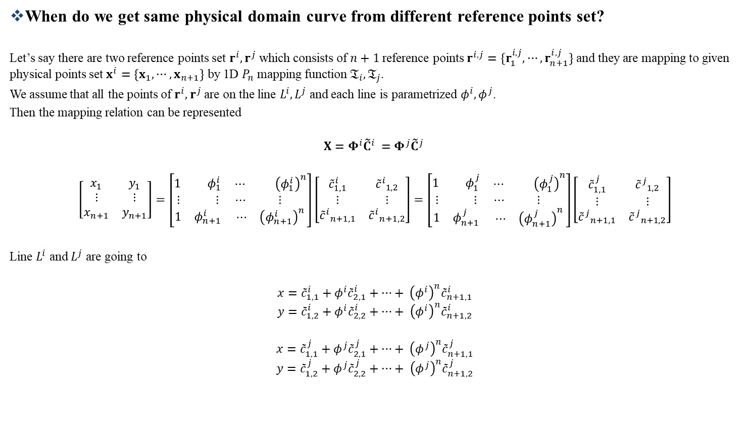
Appendix 3
When do we get same physical domain curve from different reference points set?
Let’s say there are two reference points set $r^{i},r^{j}$ which consists of $n+1$ reference points $r^{i,j}=\{r_{1}^{i,j},⋯,r_{n+1}^{i,j}\}$ and they are mapping to given physical points set $x^{i}=\{x_{1},⋯,x_{n+1}\}$ by 1D $P_{n}$ mapping function $𝔗_{i},𝔗_{j}$.
We assume that all the points of $r^{i},r^{j}$ are on the line $L^{i},L^{j}$ and each line is parametrized $φ^{i},φ^{j}$.
Then the mapping relation can be represented
$$X=Φ^{i}{{\tilde{C}}^{i}}^{ }=Φ^{j}{{\tilde{C}}^{j}}^{ }$$
$$\left[\begin{matrix}x_{1} & y_{1} \\ ⋮ & ⋮ \\ x_{n+1} & y_{n+1}\end{matrix}\right]=\left[\begin{matrix}\begin{matrix}1 & φ_{1}^{i}\end{matrix} & \begin{matrix}⋯ & {\left(φ_{1}^{i}\right)}^{n}\end{matrix} \\ \begin{matrix}⋮ & ⋮\end{matrix} & \begin{matrix}⋯ & ⋮ \end{matrix} \\ \begin{matrix}1 & φ_{n+1}^{i}\end{matrix} & \begin{matrix}⋯ & {\left(φ_{n+1}^{i}\right)}^{n}\end{matrix}\end{matrix}\right]\left[\begin{matrix}{\tilde{c}}_{1,1}^{i} & {{\tilde{c}}^{i}}_{1,2} \\ ⋮ & ⋮ \\ {{\tilde{c}}^{i}}_{n+1,1} & {{\tilde{c}}^{i}}_{n+1,2}\end{matrix}\right]=\left[\begin{matrix}\begin{matrix}1 & φ_{1}^{j}\end{matrix} & \begin{matrix}⋯ & {\left(φ_{1}^{j}\right)}^{n}\end{matrix} \\ \begin{matrix}⋮ & ⋮\end{matrix} & \begin{matrix}⋯ & ⋮ \end{matrix} \\ \begin{matrix}1 & φ_{n+1}^{j}\end{matrix} & \begin{matrix}⋯ & {\left(φ_{n+1}^{j}\right)}^{n}\end{matrix}\end{matrix}\right]\left[\begin{matrix}{\tilde{c}}_{1,1}^{j} & {{\tilde{c}}^{j}}_{1,2} \\ ⋮ & ⋮ \\ {{\tilde{c}}^{j}}_{n+1,1} & {{\tilde{c}}^{j}}_{n+1,2}\end{matrix}\right]$$
Line $L^{i}$ and $L^{j}$ are going to
$$x={\tilde{c}}_{1,1}^{i}+φ_{ }^{i}{\tilde{c}}_{2,1}^{i}+…+ {\left(φ_{ }^{i}\right)}^{n}{\tilde{c}}_{n+1,1}^{i}$$
$$y={\tilde{c}}_{1,2}^{i}+φ_{ }^{i}{\tilde{c}}_{2,2}^{i}+…+ {\left(φ_{ }^{i}\right)}^{n}{\tilde{c}}_{n+1,2}^{i}$$
$$x={\tilde{c}}_{1,1}^{j}+φ_{ }^{j}{\tilde{c}}_{2,1}^{j}+…+ {\left(φ_{ }^{j}\right)}^{n}{\tilde{c}}_{n+1,1}^{j}$$
$$y={\tilde{c}}_{1,2}^{j}+φ_{ }^{j}{\tilde{c}}_{2,2}^{j}+…+ {\left(φ_{ }^{j}\right)}^{n}{\tilde{c}}_{n+1,2}^{j}$$

Slide 8

Appendix 3
Each coefficients are determined by linear system
$$x_{k}={\tilde{c}}_{1,1}^{i}+φ_{k}^{i}{\tilde{c}}_{2,1}^{i}+…+ {\left(φ_{k}^{i}\right)}^{n}{\tilde{c}}_{n+1,1}^{i}$$
$$y_{k}={\tilde{c}}_{1,2}^{i}+φ_{k}^{i}{\tilde{c}}_{2,2}^{i}+…+ {\left(φ_{k}^{i}\right)}^{n}{\tilde{c}}_{n+1,2}^{i}$$
$$⋮$$
$$x_{k}={\tilde{c}}_{1,1}^{j}+φ_{k}^{j}{\tilde{c}}_{2,1}^{j}+…+ {\left(φ_{k}^{j}\right)}^{n}{\tilde{c}}_{n+1,1}^{j}$$
$$y_{k}={\tilde{c}}_{1,2}^{j}+φ_{k}^{j}{\tilde{c}}_{2,2}^{j}+…+ {\left(φ_{k}^{j}\right)}^{n}{\tilde{c}}_{n+1,2}^{j}$$
$$⋮$$
$$where k=1,⋯,n+1$$
If reference points set $φ_{k}^{i},φ_{k}^{j}$ have linear relation
$$φ_{k}^{i}=aφ_{k}^{j}+b where a≠0,b=const$$
We can easily know that coefficients also have a linear relation by substitute and coefficient comparison method
$${\tilde{c}}_{m,1}^{i}=a{\tilde{c}}_{m,1}^{j} where m=2,…,n+1$$
$${\tilde{c}}_{1,1}^{i}={\tilde{c}}_{1,1}^{j}+\frac{b}{a}({\tilde{c}}_{2,1}^{i}+⋯+{\tilde{c}}_{n+1,1}^{i})$$
$${\tilde{c}}_{m,2}^{i}=a{\tilde{c}}_{m,2}^{j} where m=2,…,n+1$$
$${\tilde{c}}_{1,2}^{i}={\tilde{c}}_{1,2}^{j}+\frac{b}{a}({\tilde{c}}_{2,2}^{i}+⋯+{\tilde{c}}_{n+1,2}^{i})$$

Slide 9

Appendix 3
Consequently, Line $L^{i}$ and $L^{j}$ are going to
$$x={\tilde{c}}_{1,1}^{i}+φ_{ }^{i}{\tilde{c}}_{2,1}^{i}+…+ {\left(φ_{ }^{i}\right)}^{n}{\tilde{c}}_{n+1,1}^{i}$$
$$y={\tilde{c}}_{1,2}^{i}+φ_{ }^{i}{\tilde{c}}_{2,2}^{i}+…+ {\left(φ_{ }^{i}\right)}^{n}{\tilde{c}}_{n+1,2}^{i}$$
$$x={\tilde{c}}_{1,1}^{i}−\frac{b}{a}\left({\tilde{c}}_{2,1}^{i}+⋯+{\tilde{c}}_{n+1,1}^{i}\right)+φ_{ }^{j}\frac{{\tilde{c}}_{2,1}^{i}}{a}+…+ {\left(φ_{ }^{j}\right)}^{n}\frac{{\tilde{c}}_{n+1,1}^{j}}{a}$$
$$y={\tilde{c}}_{1,2}^{i}−\frac{b}{a}\left({\tilde{c}}_{2,2}^{i}+⋯+{\tilde{c}}_{n+1,2}^{i}\right)+φ_{ }^{j}\frac{{\tilde{c}}_{2,2}^{i}}{a}+…+ {\left(φ_{ }^{j}\right)}^{n}\frac{{\tilde{c}}_{n+1,2}^{j}}{a}$$
The above relation shows that when $φ^{j}=aφ^{i}+b$ they passes same $x,y$ point.
It means that two line $L^{i},L^{j}$ becomes a same physical domain curve by two different mapping function $𝔗_{i},𝔗_{j}$.
Consequently, if we choose points set on line which have linear relation it is converted same physical curve for given physical points.

Slide 10
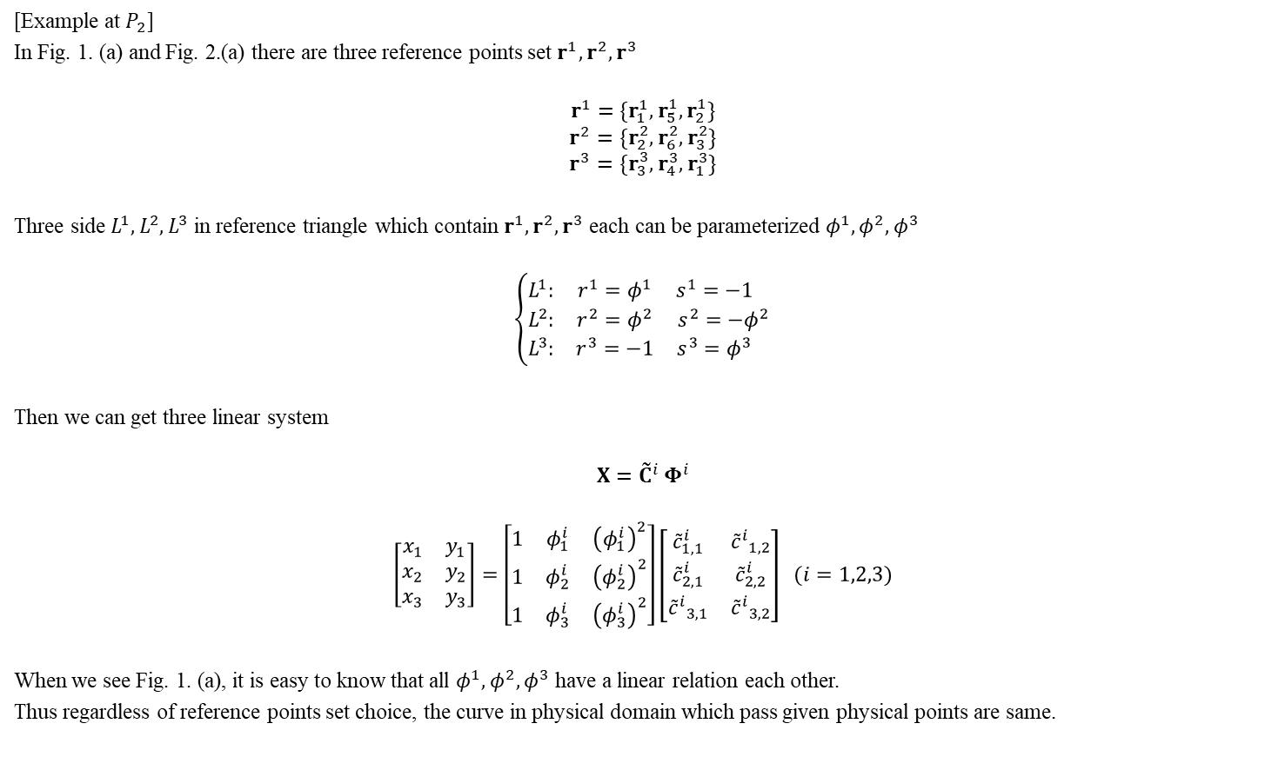
Appendix 3
[Example at $P_{2}$]
In Fig. 1. (a) and Fig. 2.(a) there are three reference points set $r^{1},r^{2},r^{3}$
$$r^{1}=\{r_{1}^{1},r_{5}^{1},r_{2}^{1}\}$$
$$r^{2}=\{r_{2}^{2},r_{6}^{2},r_{3}^{2}\}$$
$$r^{3}=\{r_{3}^{3},r_{4}^{3},r_{1}^{3}\}$$
Three side $L^{1},L^{2},L^{3}$ in reference triangle which contain $r^{1},r^{2},r^{3}$ each can be parameterized $φ^{1},φ^{2},φ^{3}$
$$\left\{\begin{matrix}L^{1}: & r^{1}=φ^{1} & s^{1}=−1 \\ L^{2}: & r^{2}=φ^{2} & s^{2}=−φ^{2} \\ L^{3}: & r^{3}=−1 & s^{3}=φ^{3} \end{matrix}\right.$$
Then we can get three linear system
$$X={{\tilde{C}}^{i}}^{ }Φ^{i}$$
$$\left[\begin{matrix}x_{1} & y_{1} \\ x_{2} & y_{2} \\ x_{3} & y_{3}\end{matrix}\right]=\left[\begin{matrix}1 & φ_{1}^{i} & {\left(φ_{1}^{i}\right)}^{2} \\ 1 & φ_{2}^{i} & {\left(φ_{2}^{i}\right)}^{2} \\ 1 & φ_{3}^{i} & {\left(φ_{3}^{i}\right)}^{2}\end{matrix}\right]\left[\begin{matrix}{\tilde{c}}_{1,1}^{i} & {{\tilde{c}}^{i}}_{1,2} \\ {\tilde{c}}_{2,1}^{i} & {\tilde{c}}_{2,2}^{i} \\ {{\tilde{c}}^{i}}_{3,1} & {{\tilde{c}}^{i}}_{3,2}\end{matrix}\right] (i=1,2,3)$$
When we see Fig. 1. (a), it is easy to know that all $φ^{1},φ^{2},φ^{3}$ have a linear relation each other.
Thus regardless of reference points set choice, the curve in physical domain which pass given physical points are same.

Slide 11
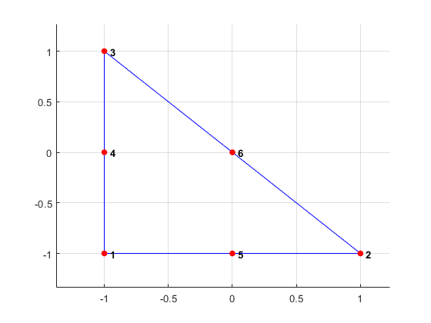
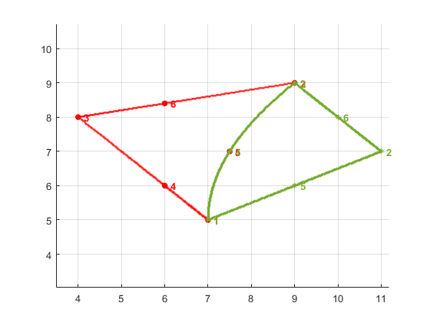
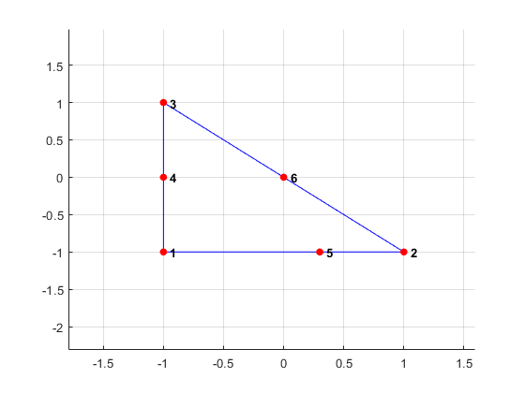
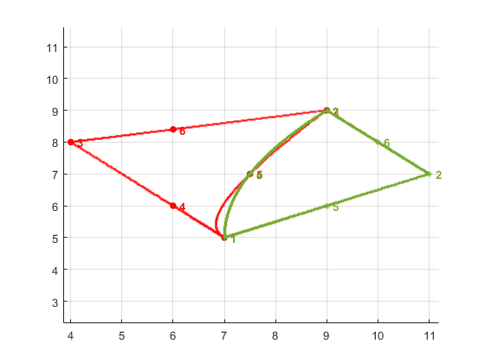





Appendix 3
But in Fig.2. (a) $φ^{2},φ^{3}$ have linear relation but $φ^{1}$ doesn’t have linear relation with $φ^{2},φ^{3}$.
Thus there will be different curves which passes given physical points when we choose reference points set $r^{1}$ and other points set.
Fig.2. (b) shows it.
$$L^{2}$$
$$L^{3}$$
$$L^{1}$$
Fig.1. (a)
Fig.1. (b)
$$L^{2}$$
$$L^{3}$$
$$L^{1}$$
Fig.2. (a)
Fig.2. (b)

Slide 12

Appendix 4
What kind of reference points give us invertible monomial matrix?
Let’s assume that we have $P_{n} 𝔗_{i}$ and consisting monomial vector is $m={\left[m_{1},…,m_{k}\right]}^{T}$
$$\left[\begin{matrix}x_{1} & y_{1} \\ ⋮ & ⋮ \\ x_{k} & y_{k}\end{matrix}\right]=\left[\begin{matrix}m_{1}(r_{1}^{i}) & ⋯ & m_{k}(r_{1}^{i}) \\ ⋮ & ⋱ & ⋮ \\ m_{1}(r_{n}^{i}) & ⋯ & m_{k}(r_{n}^{i})\end{matrix}\right]\left[\begin{matrix}c_{11} & c_{12} \\ ⋮ & ⋮ \\ c_{k1} & c_{k2}\end{matrix}\right]$$

Slide 13
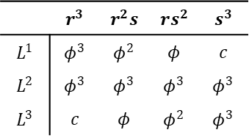

Don’t use 10 $th$ point and using monomials
$$1,r,s,r^{2},rs,s^{2},r^{3},rs^{2},s^{3} :o$$
$$1,r,s,r^{2},rs,s^{2},r^{3},r^{2}s,s^{3} :o$$
$$1,r,s,r^{2},rs,s^{2},r^{3},r^{2}s,rs^{2} :x$$
$$1,r,s,r^{2},rs,s^{2}, r^{2}s,rs^{2},s^{3} :x$$
Failure occur when it make singular matrix.
When they make singular matrix ?
If we select monomials without $r^{3}$ or $s^{3}$, $L^{1}$ or $L^{3}$ side become $P_{2}$ function.
Since we put 4 points on every sides, one of the side have too many points.
Thus singular matrix appear.
 | $$r^{3}$$ | $$r^{2}s$$ | $$rs^{2}$$ | $$s^{3}$$
$$L^{1}$$ | $$φ^{3}$$ | $$φ^{2}$$ | $$φ$$ | $$c$$
$$L^{2}$$ | $$φ^{3}$$ | $$φ^{3}$$ | $$φ^{3}$$ | $$φ^{3}$$
$$L^{3}$$ | $$c$$ | $$φ$$ | $$φ^{2}$$ | $$φ^{3}$$

Slide 14
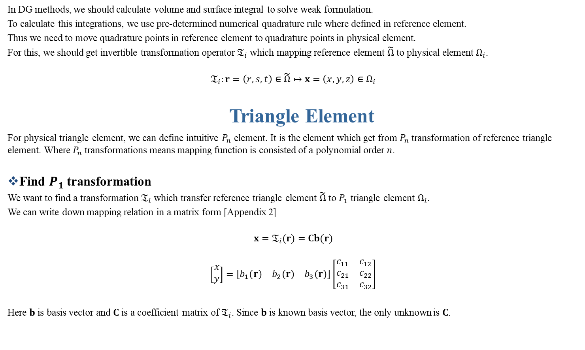
In DG methods, we should calculate volume and surface integral to solve weak formulation.
To calculate this integrations, we use pre-determined numerical quadrature rule where defined in reference element.
Thus we need to move quadrature points in reference element to quadrature points in physical element.
For this, we should get invertible transformation operator $𝔗_{i}$ which mapping reference element $\tilde{Ω}$ to physical element $Ω_{i}$.
$$𝔗_{i}:r=\left(r,s,t\right)∈\tilde{Ω}↦x=\left(x,y,z\right)∈Ω_{i}$$
Triangle Element
For physical triangle element, we can define intuitive $P_{n}$ element. It is the element which get from $P_{n}$ transformation of reference triangle element. Where $P_{n}$ transformations means mapping function is consisted of a polynomial order $n$.
Find $P_{1}$ transformation
We want to find a transformation $𝔗_{i}$ which transfer reference triangle element $\tilde{Ω}$ to $P_{1}$ triangle element $Ω_{i}$.
We can write down mapping relation in a matrix form [Appendix 2]
$$x=𝔗_{i}(r)=Cb(r)$$
$$\left[\begin{aligned}x \\ y\end{aligned}\right]=\left[\begin{matrix}b_{1}(r) & b_{2}(r) & b_{3}(r)\end{matrix}\right]\left[\begin{matrix}\begin{aligned}c_{11} \\ c_{21} \\ c_{31}\end{aligned} & \begin{aligned}c_{12} \\ c_{22} \\ c_{32}\end{aligned}\end{matrix}\right]$$
Here $b$ is basis vector and $C$ is a coefficient matrix of $𝔗_{i}$. Since $b$ is known basis vector, the only unknown is $C$.

Slide 15
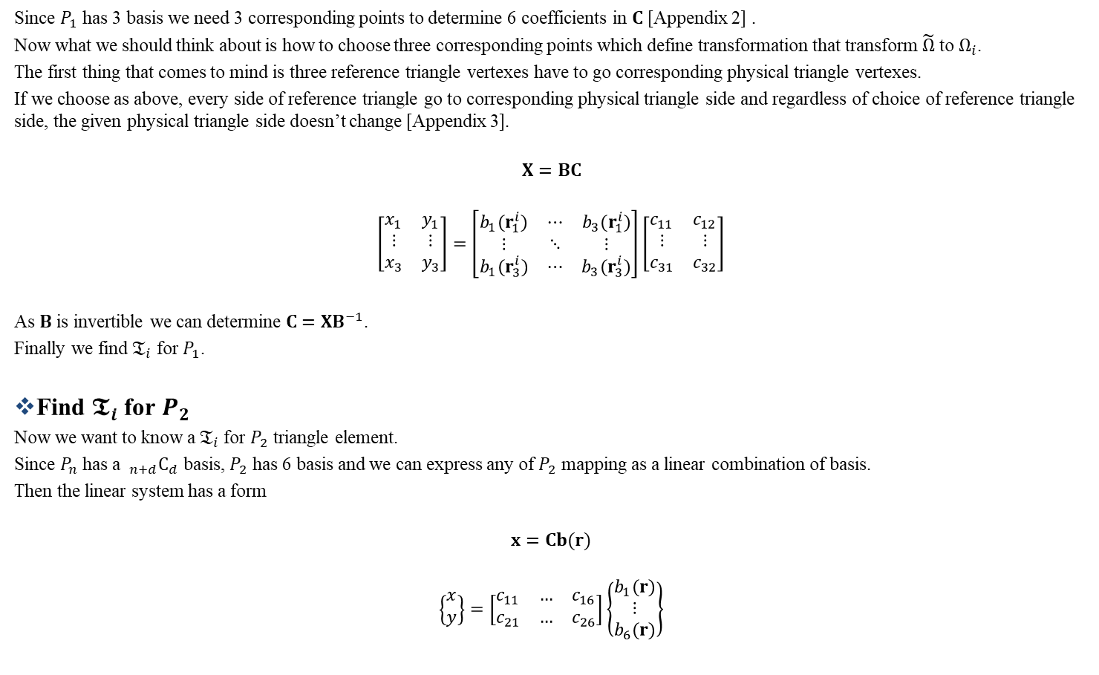
Transformation
Since $P_{1}$ has 3 basis we need 3 corresponding points to determine 6 coefficients in $C$ [Appendix 2] .
Now what we should think about is how to choose three corresponding points which define transformation that transform $\tilde{Ω}$ to $Ω_{i}$.
The first thing that comes to mind is three reference triangle vertexes have to go corresponding physical triangle vertexes.
If we choose as above, every side of reference triangle go to corresponding physical triangle side and regardless of choice of reference triangle side, the given physical triangle side doesn’t change [Appendix 3].
$$X=BC$$
$$\left[\begin{matrix}x_{1} & y_{1} \\ ⋮ & ⋮ \\ x_{3} & y_{3}\end{matrix}\right]=\left[\begin{matrix}b_{1}(r_{1}^{i}) & ⋯ & b_{3}(r_{1}^{i}) \\ ⋮ & ⋱ & ⋮ \\ b_{1}(r_{3}^{i}) & ⋯ & b_{3}(r_{3}^{i})\end{matrix}\right]\left[\begin{matrix}c_{11} & c_{12} \\ ⋮ & ⋮ \\ c_{31} & c_{32}\end{matrix}\right]$$
As $B$ is invertible we can determine $C=XB^{−1}$.
Finally we find $𝔗_{i}$ for $P_{1}$.
Find $𝕿_{i}$ for $P_{2}$
Now we want to know a $𝔗_{i}$ for $P_{2}$ triangle element.
Since $P_{n}$ has a $_{n+d}C_{d}$ basis, $P_{2}$ has 6 basis and we can express any of $P_{2}$ mapping as a linear combination of basis.
Then the linear system has a form
$$x=Cb(r)$$
$$\left\{\begin{matrix}x \\ y\end{matrix}\right\}=\left[\begin{matrix}c_{11} & … & c_{16} \\ c_{21} & … & c_{26}\end{matrix}\right]\left\{\begin{matrix}b_{1}(r) \\ ⋮ \\ b_{6}(r)\end{matrix}\right\}$$

Slide 16
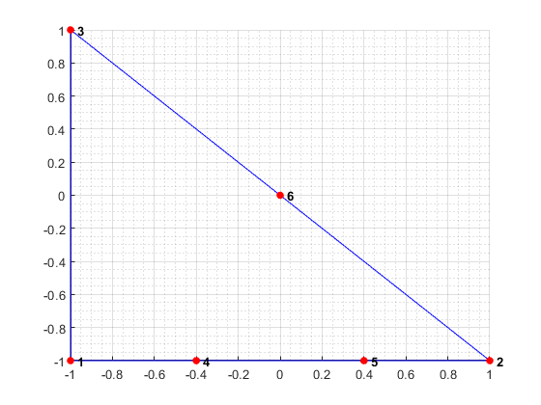
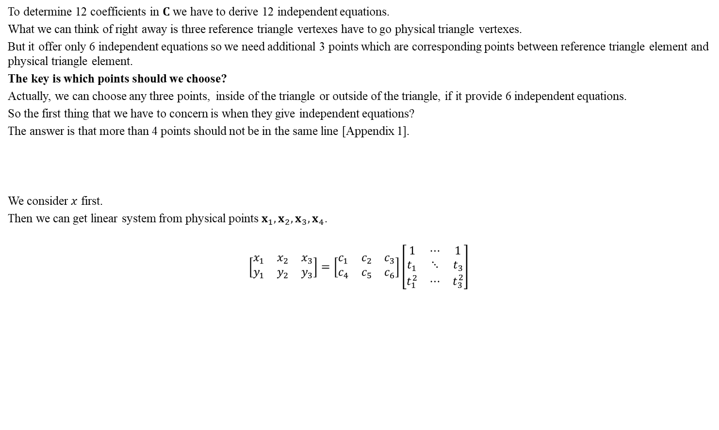
To determine 12 coefficients in $C$ we have to derive 12 independent equations.
What we can think of right away is three reference triangle vertexes have to go physical triangle vertexes.
But it offer only 6 independent equations so we need additional 3 points which are corresponding points between reference triangle element and physical triangle element.
The key is which points should we choose?
Actually, we can choose any three points, inside of the triangle or outside of the triangle, if it provide 6 independent equations.
So the first thing that we have to concern is when they give independent equations?
The answer is that more than 4 points should not be in the same line [Appendix 1].
We consider $x$ first.
Then we can get linear system from physical points $x_{1},x_{2},x_{3},x_{4}$.
$$\left[\begin{matrix}x_{1} & x_{2} & x_{3} \\ y_{1} & y_{2} & y_{3}\end{matrix}\right]=\left[\begin{matrix}c_{1} & c_{2} & c_{3} \\ c_{4} & c_{5} & c_{6}\end{matrix}\right]\left[\begin{matrix}1 & ⋯ & 1 \\ t_{1} & ⋱ & t_{3} \\ t_{1}^{2} & ⋯ & t_{3}^{2}\end{matrix}\right]$$

Slide 17
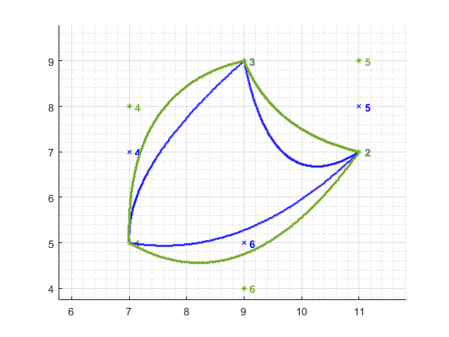
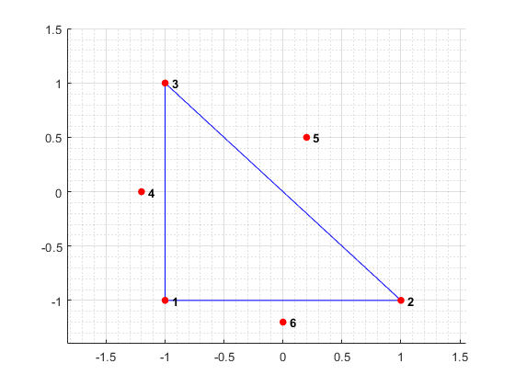
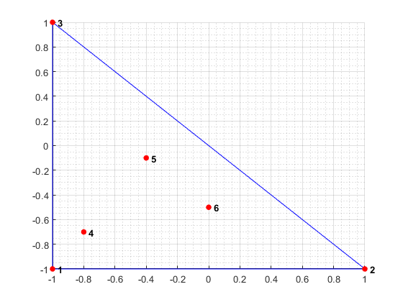
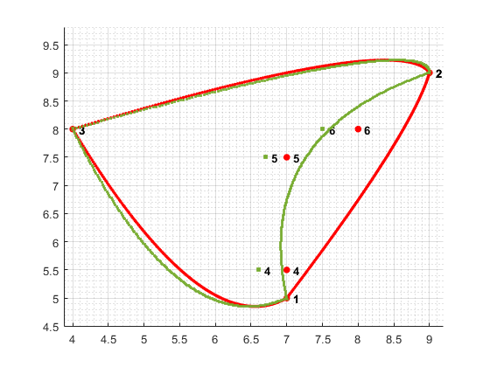

$x_{1},x_{2},x_{3}$ are given and $t_{1},t_{2},t_{3}$ are -1 0 1 for any side in reference triangle.
It means $c_{1},…,c_{6}$ are uniquely determined when $x_{1},x_{2},x_{3}$ are given regardless of choice of side in reference triangle.
If we choose arbitrary points inside of reference triangle such as fig 1.
We have to know corresponding three points in every $P_{2}$ triangle element to the reference point 4, 5, 6.
Fig2 shows that different shape $P_{2}$ triangle element need different corresponding node coordinates.

Slide 19
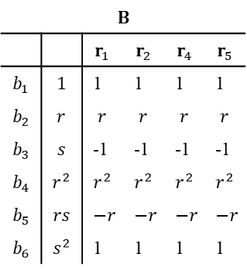
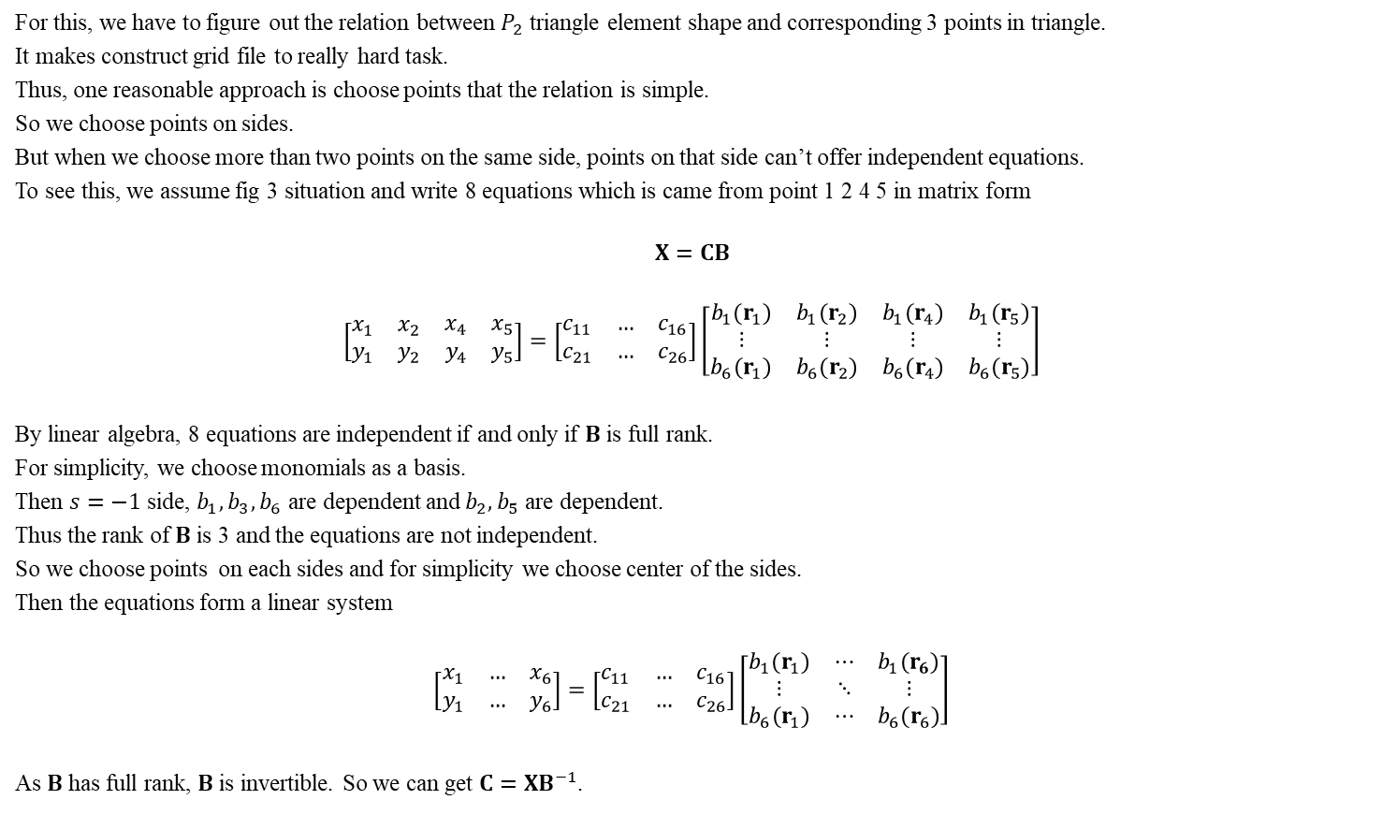
For this, we have to figure out the relation between $P_{2}$ triangle element shape and corresponding 3 points in triangle.
It makes construct grid file to really hard task.
Thus, one reasonable approach is choose points that the relation is simple.
So we choose points on sides.
But when we choose more than two points on the same side, points on that side can’t offer independent equations.
To see this, we assume fig 3 situation and write 8 equations which is came from point 1 2 4 5 in matrix form
$$X=CB$$
$$\left[\begin{matrix}\begin{matrix}x_{1} & x_{2}\end{matrix} & \begin{matrix}x_{4} & x_{5}\end{matrix} \\ \begin{matrix}y_{1} & y_{2}\end{matrix} & \begin{matrix}y_{4} & y_{5}\end{matrix}\end{matrix}\right]=\left[\begin{matrix}c_{11} & … & c_{16} \\ c_{21} & … & c_{26}\end{matrix}\right]\left[\begin{matrix}\begin{matrix}\begin{matrix}b_{1}(r_{1}) \\ ⋮ \\ b_{6}(r_{1})\end{matrix} & \begin{matrix}b_{1}(r_{2}) \\ ⋮ \\ b_{6}(r_{2})\end{matrix}\end{matrix} & \begin{matrix}\begin{matrix}b_{1}(r_{4}) \\ ⋮ \\ b_{6}(r_{4})\end{matrix} & \begin{matrix}b_{1}(r_{5}) \\ ⋮ \\ b_{6}(r_{5})\end{matrix}\end{matrix}\end{matrix}\right]$$
By linear algebra, 8 equations are independent if and only if $B$ is full rank.
For simplicity, we choose monomials as a basis.
Then $s=−1$ side, $b_{1},b_{3},b_{6}$ are dependent and $b_{2},b_{5}$ are dependent.
Thus the rank of $B$ is 3 and the equations are not independent.
So we choose points on each sides and for simplicity we choose center of the sides.
Then the equations form a linear system
$$\left[\begin{matrix}x_{1} & … & x_{6} \\ y_{1} & … & y_{6}\end{matrix}\right]=\left[\begin{matrix}c_{11} & … & c_{16} \\ c_{21} & … & c_{26}\end{matrix}\right]\left[\begin{matrix}b_{1}(r_{1}) & ⋯ & b_{1}(r_{6}) \\ ⋮ & ⋱ & ⋮ \\ b_{6}(r_{1}) & ⋯ & b_{6}(r_{6})\end{matrix}\right]$$
As $B$ has full rank, $B$ is invertible. So we can get $C=XB^{−1}$.
$$B$$
 |  | $$r_{1}$$ | $$r_{2}$$ | $$r_{4}$$ | $$r_{5}$$
$$b_{1}$$ | $$1$$ | 1 | 1 | 1 | 1
$$b_{2}$$ | $$r$$ | $$r$$ | $$r$$ | $$r$$ | $$r$$
$$b_{3}$$ | $$s$$ | -1 | -1 | -1 | -1
$$b_{4}$$ | $$r^{2}$$ | $$r^{2}$$ | $$r^{2}$$ | $$r^{2}$$ | $$r^{2}$$
$$b_{5}$$ | $$rs$$ | $$−r$$ | $$−r$$ | $$−r$$ | $$−r$$
$$b_{6}$$ | $$s^{2}$$ | 1 | 1 | 1 | 1

Slide 20
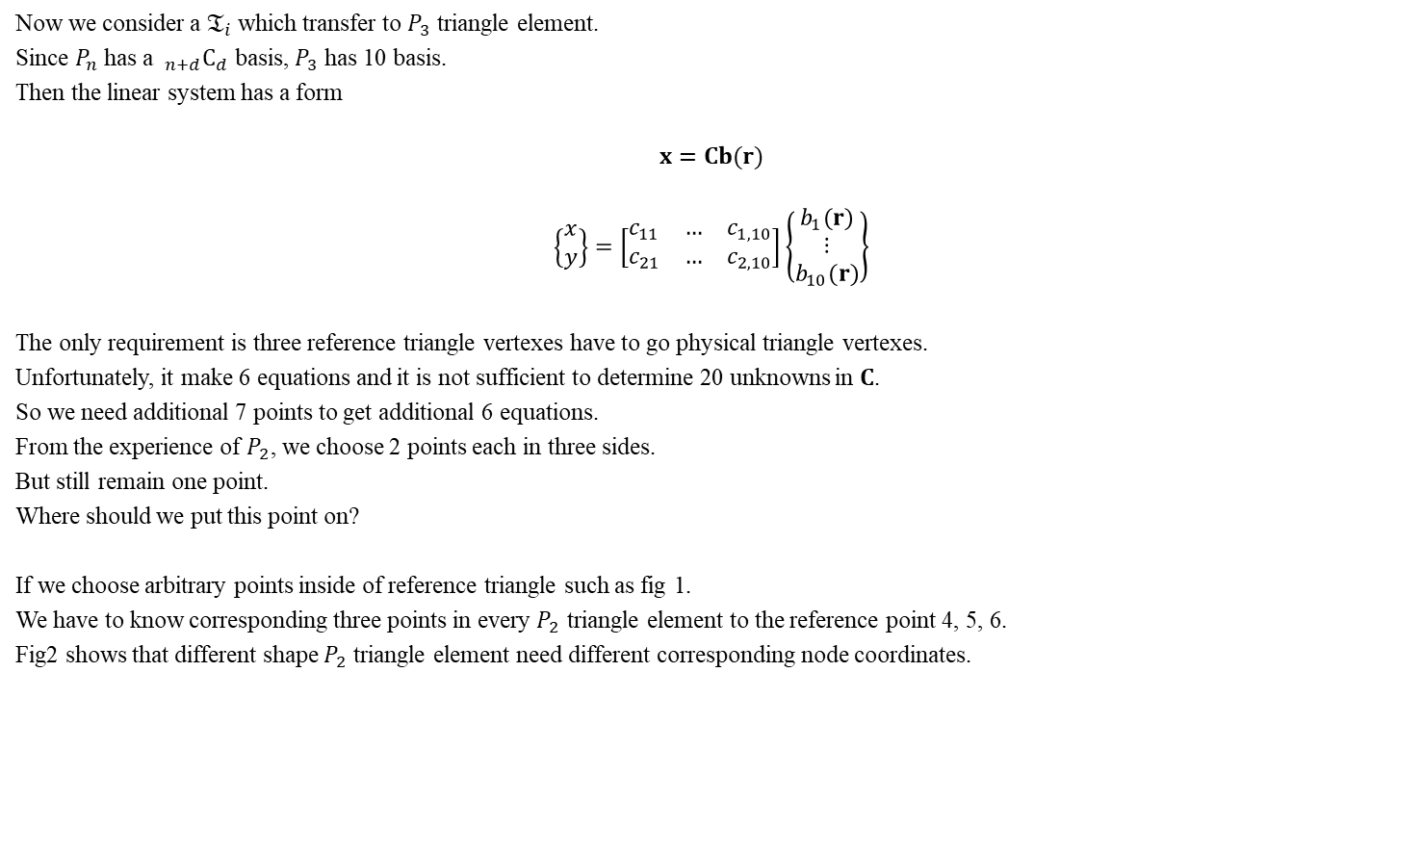
Now we consider a $𝔗_{i}$ which transfer to $P_{3}$ triangle element.
Since $P_{n}$ has a $_{n+d}C_{d}$ basis, $P_{3}$ has 10 basis.
Then the linear system has a form
$$x=Cb(r)$$
$$\left\{\begin{matrix}x \\ y\end{matrix}\right\}=\left[\begin{matrix}c_{11} & … & c_{1,10} \\ c_{21} & … & c_{2,10}\end{matrix}\right]\left\{\begin{matrix}b_{1}(r) \\ ⋮ \\ b_{10}(r)\end{matrix}\right\}$$
The only requirement is three reference triangle vertexes have to go physical triangle vertexes.
Unfortunately, it make 6 equations and it is not sufficient to determine 20 unknowns in $C$.
So we need additional 7 points to get additional 6 equations.
From the experience of $P_{2}$, we choose 2 points each in three sides.
But still remain one point.
Where should we put this point on?
If we choose arbitrary points inside of reference triangle such as fig 1.
We have to know corresponding three points in every $P_{2}$ triangle element to the reference point 4, 5, 6.
Fig2 shows that different shape $P_{2}$ triangle element need different corresponding node coordinates.

Slide 21
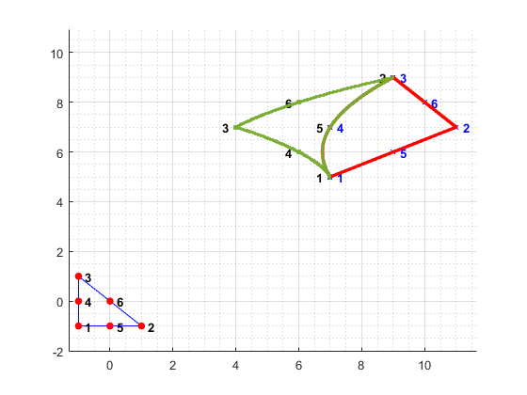

Appendix 1
Why side which pass 3 points in $P_{2}$ triangle element is unique?
Any side in reference triangle can be parameterized by one variable $t$ and it have values -1 0 1.
As we have $P_{2}$ mapping, we can express physical variable
$$x=c_{1}+c_{2}t+c_{3}t^{2}$$
$$y=c_{4}+c_{5}t+c_{6}t^{2}$$
Then we can get linear system from physical points $x_{1},x_{2},x_{3}$.
$$\left[\begin{matrix}x_{1} & x_{2} & x_{3} \\ y_{1} & y_{2} & y_{3}\end{matrix}\right]=\left[\begin{matrix}c_{1} & c_{2} & c_{3} \\ c_{4} & c_{5} & c_{6}\end{matrix}\right]\left[\begin{matrix}1 & ⋯ & 1 \\ t_{1} & ⋱ & t_{3} \\ t_{1}^{2} & ⋯ & t_{3}^{2}\end{matrix}\right]$$
$x_{1},x_{2},x_{3}$ are given and $t_{1},t_{2},t_{3}$ are -1 0 1 for any side in reference triangle.
It means $c_{1},…,c_{6}$ are uniquely determined when $x_{1},x_{2},x_{3}$ are given regardless of choice of side in reference triangle.

Slide 22
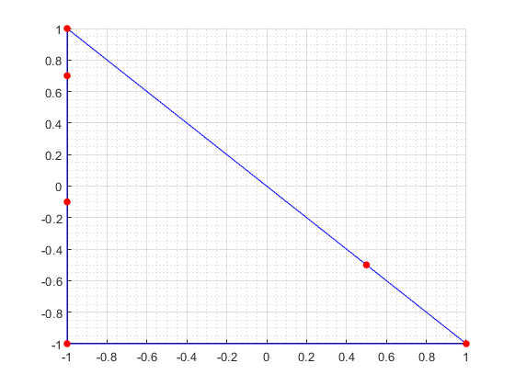
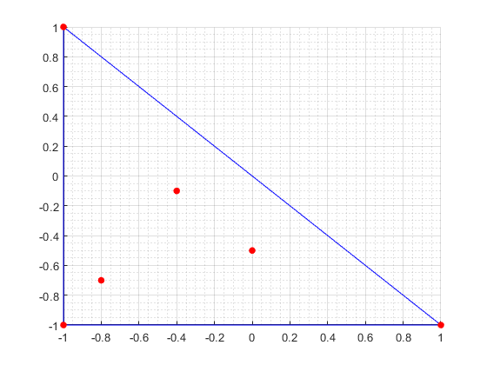

First we should consider a condition for confirming mesh.
$$\left[\begin{matrix}x_{1} & … & x_{6} \\ y_{1} & … & y_{6}\end{matrix}\right]=\left[\begin{matrix}c_{11} & … & c_{16} \\ c_{21} & … & c_{26}\end{matrix}\right]\left[\begin{matrix}b_{1}(r_{1}) & ⋯ & b_{1}(r_{6}) \\ ⋮ & ⋱ & ⋮ \\ b_{6}(r_{1}) & ⋯ & b_{6}(r_{6})\end{matrix}\right]$$
$$x=B^{T}c_{1}$$

Slide 23
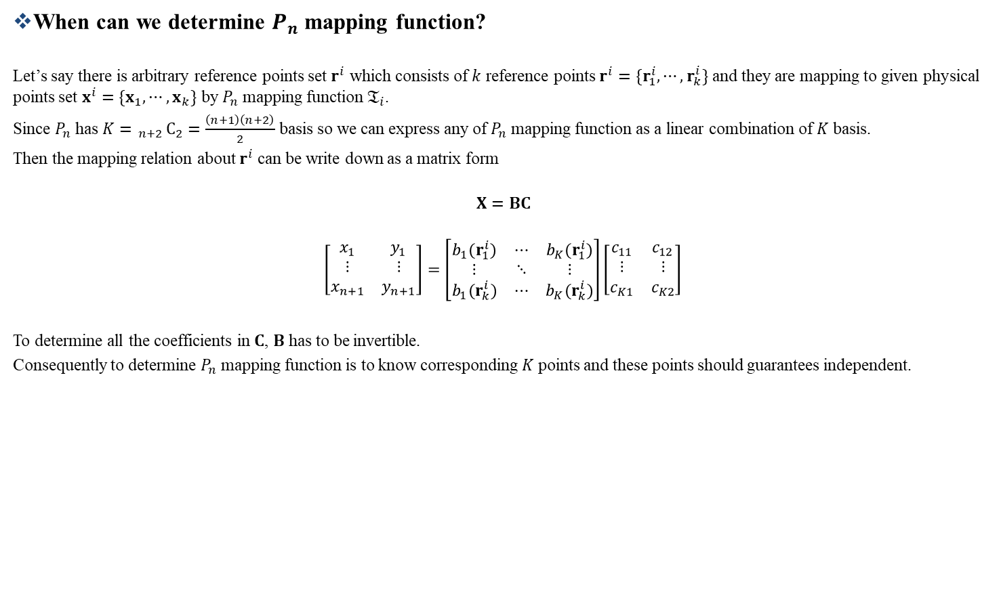
Appendix 2
When can we determine $P_{n}$ mapping function?
Let’s say there is arbitrary reference points set $r^{i}$ which consists of $k$ reference points $r^{i}=\{r_{1}^{i},⋯,r_{k}^{i}\}$ and they are mapping to given physical points set $x^{i}=\{x_{1},⋯,x_{k}\}$ by $P_{n}$ mapping function $𝔗_{i}$.
Since $P_{n}$ has $K= _{n+2}C_{2}=\frac{\left(n+1\right)\left(n+2\right)}{2}$ basis so we can express any of $P_{n}$ mapping function as a linear combination of $K$ basis.
Then the mapping relation about $r^{i}$ can be write down as a matrix form
$$X=BC$$
$$\left[\begin{matrix}x_{1} & y_{1} \\ ⋮ & ⋮ \\ x_{n+1} & y_{n+1}\end{matrix}\right]=\left[\begin{matrix}b_{1}(r_{1}^{i}) & ⋯ & b_{K}(r_{1}^{i}) \\ ⋮ & ⋱ & ⋮ \\ b_{1}(r_{k}^{i}) & ⋯ & b_{K}(r_{k}^{i})\end{matrix}\right]\left[\begin{matrix}c_{11} & c_{12} \\ ⋮ & ⋮ \\ c_{K1} & c_{K2}\end{matrix}\right]$$
To determine all the coefficients in $C$, $B$ has to be invertible.
Consequently to determine $P_{n}$ mapping function is to know corresponding $K$ points and these points should guarantees independent.

Slide 24
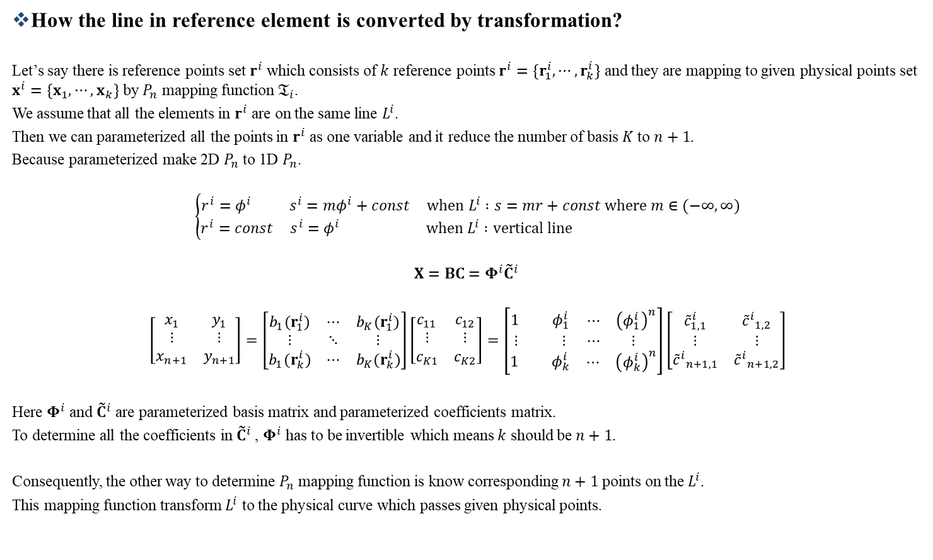
Appendix 3
How the line in reference element is converted by transformation?
Let’s say there is reference points set $r^{i}$ which consists of $k$ reference points $r^{i}=\{r_{1}^{i},⋯,r_{k}^{i}\}$ and they are mapping to given physical points set $x^{i}=\{x_{1},⋯,x_{k}\}$ by $P_{n}$ mapping function $𝔗_{i}$.
We assume that all the elements in $r^{i}$ are on the same line $L^{i}$.
Then we can parameterized all the points in $r^{i}$ as one variable and it reduce the number of basis $K$ to $n+1$.
Because parameterized make 2D $P_{n}$ to 1D $P_{n}$.
$$\left\{\begin{matrix}r^{i}=φ^{i} & s^{i}=mφ^{i}+const & when L^{i} :s=mr+const where m∈(−∞,∞) \\ r^{i}=const & s^{i}=φ^{i} & when L^{i} :vertical line \end{matrix}\right.$$
$$X=BC=Φ^{i}{{\tilde{C}}^{i}}^{ }$$
$$\left[\begin{matrix}x_{1} & y_{1} \\ ⋮ & ⋮ \\ x_{n+1} & y_{n+1}\end{matrix}\right]=\left[\begin{matrix}b_{1}(r_{1}^{i}) & ⋯ & b_{K}(r_{1}^{i}) \\ ⋮ & ⋱ & ⋮ \\ b_{1}(r_{k}^{i}) & ⋯ & b_{K}(r_{k}^{i})\end{matrix}\right]\left[\begin{matrix}c_{11} & c_{12} \\ ⋮ & ⋮ \\ c_{K1} & c_{K2}\end{matrix}\right]=\left[\begin{matrix}\begin{matrix}1 & φ_{1}^{i}\end{matrix} & \begin{matrix}⋯ & {\left(φ_{1}^{i}\right)}^{n}\end{matrix} \\ \begin{matrix}⋮ & ⋮\end{matrix} & \begin{matrix}⋯ & ⋮ \end{matrix} \\ \begin{matrix}1 & φ_{k}^{i}\end{matrix} & \begin{matrix}⋯ & {\left(φ_{k}^{i}\right)}^{n}\end{matrix}\end{matrix}\right]\left[\begin{matrix}{\tilde{c}}_{1,1}^{i} & {{\tilde{c}}^{i}}_{1,2} \\ ⋮ & ⋮ \\ {{\tilde{c}}^{i}}_{n+1,1} & {{\tilde{c}}^{i}}_{n+1,2}\end{matrix}\right]$$
Here $Φ^{i}$ and ${\tilde{C}}^{i}$ are parameterized basis matrix and parameterized coefficients matrix.
To determine all the coefficients in ${{\tilde{C}}^{i}}^{ }$, $Φ^{i}$ has to be invertible which means $k$ should be $n+1$.
Consequently, the other way to determine $P_{n}$ mapping function is know corresponding $n+1$ points on the $L^{i}$.
This mapping function transform $L^{i}$ to the physical curve which passes given physical points.

Slide 25

Appendix 2
When can we get physical curve from transformation?
The reason that we need corresponding $K$ points is the number of basis for mapping function space.
Thus if we can reduce the mapping function space we can determine $P_{n}$ mapping function less than $K$ points.
It becomes possible by using points on the same line $L^{i}$.
On the same line $L^{i}$, we can parameterized all the points in one variable and it reduce the number of basis $K$ to $n+1$.
Because parameterized make 2D $P_{n}$ to 1D $P_{n}$.
$$\left\{\begin{matrix}r^{i}=φ^{i} & s^{i}=mφ^{i}+const & when L^{i} :s=mr+const where m∈(−∞,∞) \\ r^{i}=const & s^{i}=φ^{i} & when L^{i} :vertical line \end{matrix}\right.$$
$$X=BC=Φ^{i}{{\tilde{C}}^{i}}^{ }$$
$$\left[\begin{matrix}x_{1} & y_{1} \\ ⋮ & ⋮ \\ x_{n+1} & y_{n+1}\end{matrix}\right]=\left[\begin{matrix}b_{1}(r_{1}^{i}) & ⋯ & b_{K}(r_{1}^{i}) \\ ⋮ & ⋱ & ⋮ \\ b_{1}(r_{k}^{i}) & ⋯ & b_{K}(r_{k}^{i})\end{matrix}\right]\left[\begin{matrix}c_{11} & c_{12} \\ ⋮ & ⋮ \\ c_{K1} & c_{K2}\end{matrix}\right]=\left[\begin{matrix}\begin{matrix}1 & φ_{1}^{i}\end{matrix} & \begin{matrix}⋯ & {\left(φ_{1}^{i}\right)}^{n}\end{matrix} \\ \begin{matrix}⋮ & ⋮\end{matrix} & \begin{matrix}⋯ & ⋮ \end{matrix} \\ \begin{matrix}1 & φ_{k}^{i}\end{matrix} & \begin{matrix}⋯ & {\left(φ_{k}^{i}\right)}^{n}\end{matrix}\end{matrix}\right]\left[\begin{matrix}{\tilde{c}}_{1,1}^{i} & {{\tilde{c}}^{i}}_{1,2} \\ ⋮ & ⋮ \\ {{\tilde{c}}^{i}}_{n+1,1} & {{\tilde{c}}^{i}}_{n+1,2}\end{matrix}\right]$$
Here $Φ^{i}$ and ${\tilde{C}}^{i}$ are parameterized basis matrix and parameterized coefficients matrix.
To determine all the coefficients in ${{\tilde{C}}^{i}}^{ }$, $Φ^{i}$ has to be invertible which means $k$ should be $n+1$.
Consequently, the other way to determine $P_{n}$ mapping function is know corresponding $n+1$ points on the $L^{i}$.
This mapping function transform $L^{i}$ to the physical curve which passes given physical points.

Slide 26





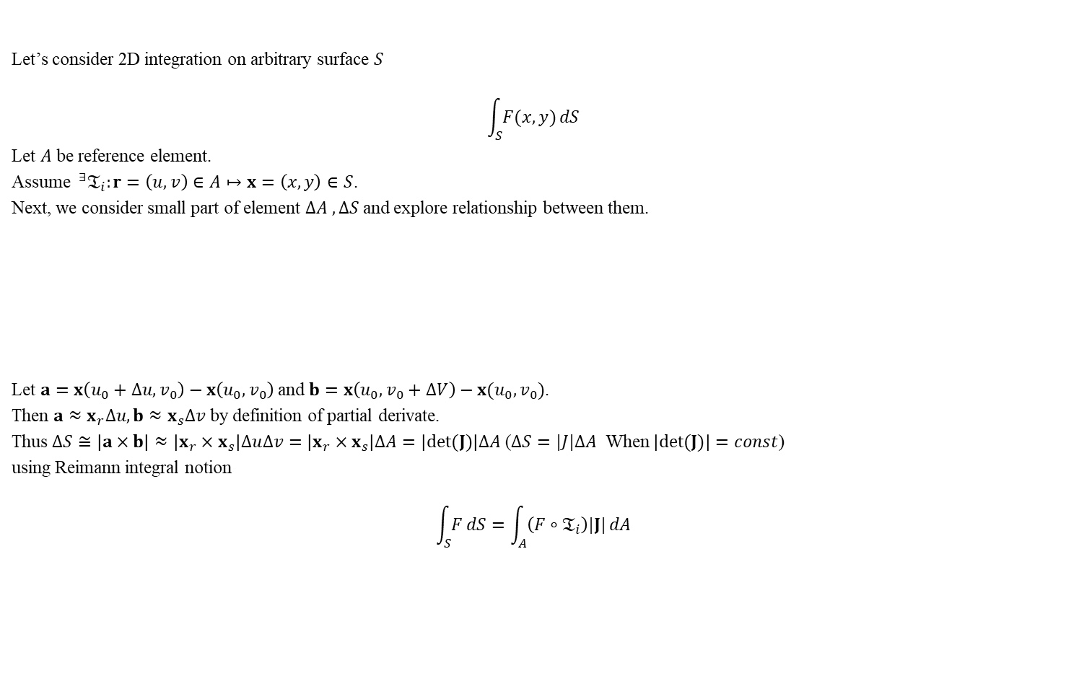








Appendix 1 Integral Domain Transformation of Volume Integral
Let’s consider 2D integration on arbitrary surface $S$
$$\int_{S}{F(x,y)}dS$$
Let $A$ be reference element.
Assume $^{∃}𝔗_{i}:r=\left(u,v\right)∈A↦x=\left(x,y\right)∈S$.
Next, we consider small part of element $∆A , ∆S$ and explore relationship between them.
Let $a=x\left(u_{0}+∆u,v_{0}\right)−x\left(u_{0},v_{0}\right)$ and $b=x\left(u_{0},v_{0}+∆V\right)−x(u_{0},v_{0})$.
Then $a≈x_{r}∆u, b≈x_{s}∆v$ by definition of partial derivate.
Thus $∆S≅\left|a×b\right|≈\left|x_{r}×x_{s}\right|∆u∆v=\left|x_{r}×x_{s}\right|∆A=\left|det⁡(J)\right|∆A$ ($∆S=|J|∆A$ When $\left|det(J)\right|=const$)
using Reimann integral notion
$$\int_{S}{F}dS=\int_{A}{\left(F∘𝔗_{i}\right)|J|}dA$$
$$v$$
$$∆u$$
$$y$$
$$∆A$$
$∆$S
$$∆v$$
$$𝔗_{i}$$
$$b$$
$$\left(u_{0},v_{0}\right)$$
$$\left(x_{0},y_{0}\right)$$
$$a$$
$$u$$
$$x$$

Slide 27
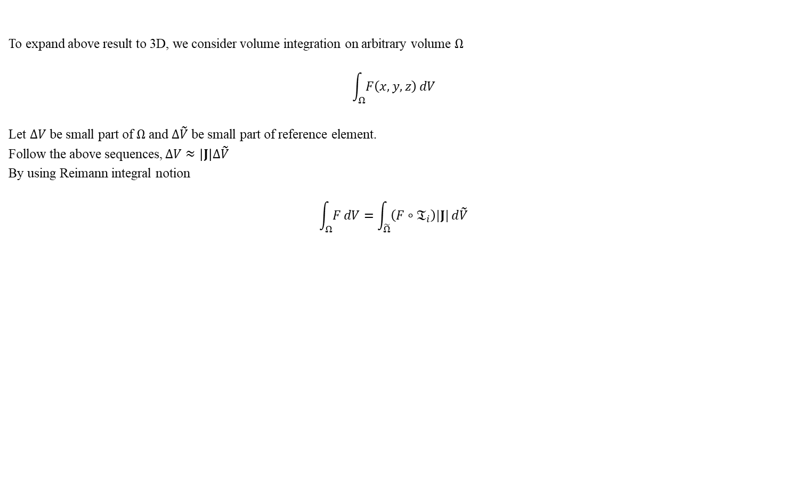
Appendix 1 Transformation of Volume Integral
To expand above result to 3D, we consider volume integration on arbitrary volume $Ω$
$$\int_{Ω}{F\left(x,y,z\right)}dV$$
Let $∆V$ be small part of $Ω$ and $∆\tilde{V}$ be small part of reference element.
Follow the above sequences, $∆V≈\left|J\right|∆\tilde{V}$
By using Reimann integral notion
$$\int_{Ω}{F}dV=\int_{\tilde{Ω}}{\left(F∘𝔗_{i}\right)|J|}d\tilde{V}$$

Slide 28
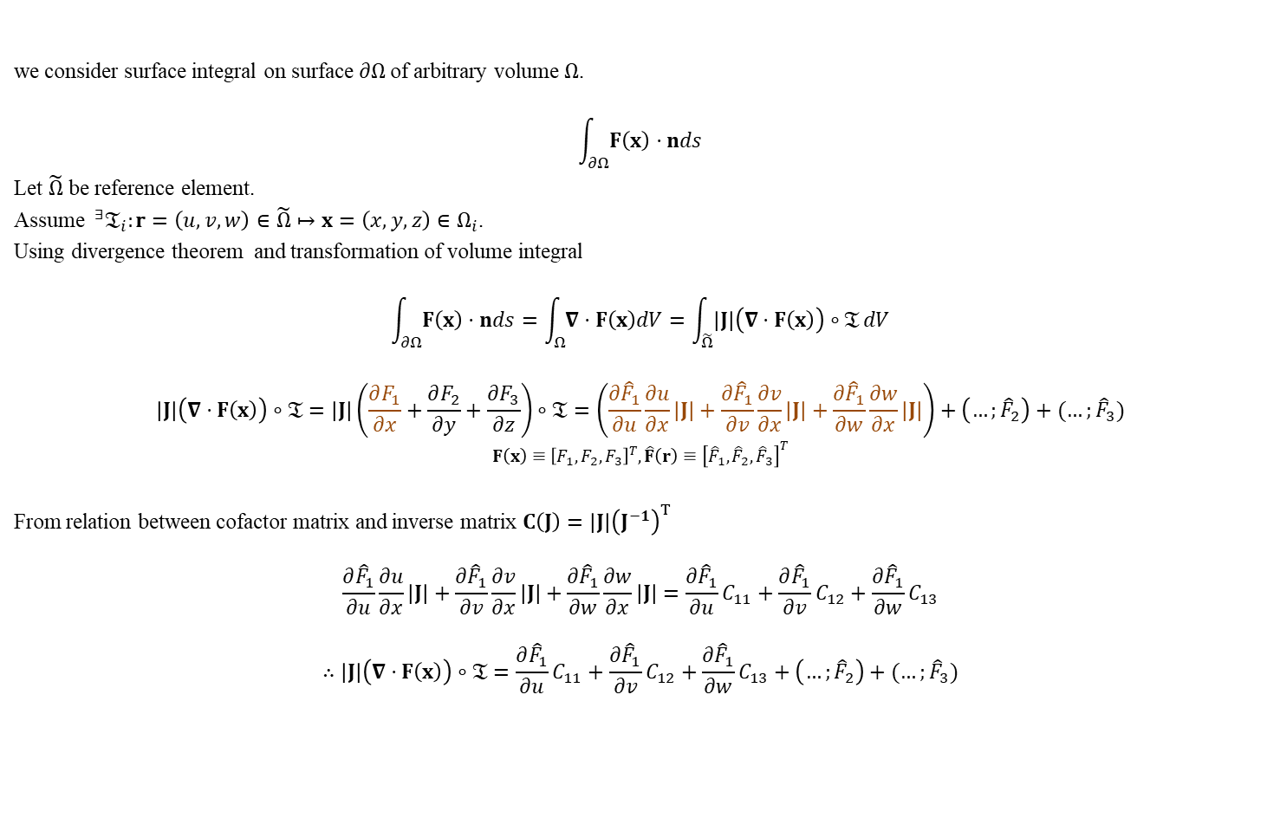
Appendix 2 Transformation of Surface Integral
we consider surface integral on surface $∂Ω$of arbitrary volume $Ω$.
$$\int_{∂Ω}{F\left(x\right)⋅nds}$$
Let $\tilde{Ω}$ be reference element.
Assume $^{∃}𝔗_{i}:r=\left(u,v,w\right)∈\tilde{Ω}↦x=\left(x,y,z\right)∈Ω_{i}$.
Using divergence theorem and transformation of volume integral
$$\int_{∂Ω}{F\left(x\right)⋅nds}=\int_{Ω}{∇⋅F\left(x\right)dV}=\int_{\tilde{Ω}}{\left|J\right|\left(∇⋅F\left(x\right)\right)∘𝔗}dV$$
$$\left|J\right|\left(∇⋅F\left(x\right)\right)∘𝔗=\left|J\right|\left(\frac{∂F_{1}}{∂x}+\frac{∂F_{2}}{∂y}+\frac{∂F_{3}}{∂z}\right)∘𝔗=\left(\frac{∂{\hat{F}}_{1}}{∂u}\frac{∂u}{∂x}\left|J\right|+\frac{∂{\hat{F}}_{1}}{∂v}\frac{∂v}{∂x}\left|J\right|+\frac{∂{\hat{F}}_{1}}{∂w}\frac{∂w}{∂x}\left|J\right|\right)+\left(…;{\hat{F}}_{2}\right)+(…;{\hat{F}}_{3})$$
$$F\left(x\right)≡{\left[F_{1},F_{2},F_{3}\right]}^{T},\hat{F}\left(r\right)≡{\left[{\hat{F}}_{1},{\hat{F}}_{2},{\hat{F}}_{3}\right]}^{T}$$
From relation between cofactor matrix and inverse matrix $C\left(J\right)=\left|J\right|{\left(J^{−1}\right)}^{T}$
$$\frac{∂{\hat{F}}_{1}}{∂u}\frac{∂u}{∂x}\left|J\right|+\frac{∂{\hat{F}}_{1}}{∂v}\frac{∂v}{∂x}\left|J\right|+\frac{∂{\hat{F}}_{1}}{∂w}\frac{∂w}{∂x}\left|J\right|=\frac{∂{\hat{F}}_{1}}{∂u}C_{11}+\frac{∂{\hat{F}}_{1}}{∂v}C_{12}+\frac{∂{\hat{F}}_{1}}{∂w}C_{13}$$
$$∴\left|J\right|\left(∇⋅F\left(x\right)\right)∘𝔗=\frac{∂{\hat{F}}_{1}}{∂u}C_{11}+\frac{∂{\hat{F}}_{1}}{∂v}C_{12}+\frac{∂{\hat{F}}_{1}}{∂w}C_{13}+\left(…;{\hat{F}}_{2}\right)+(…;{\hat{F}}_{3})$$

Slide 29
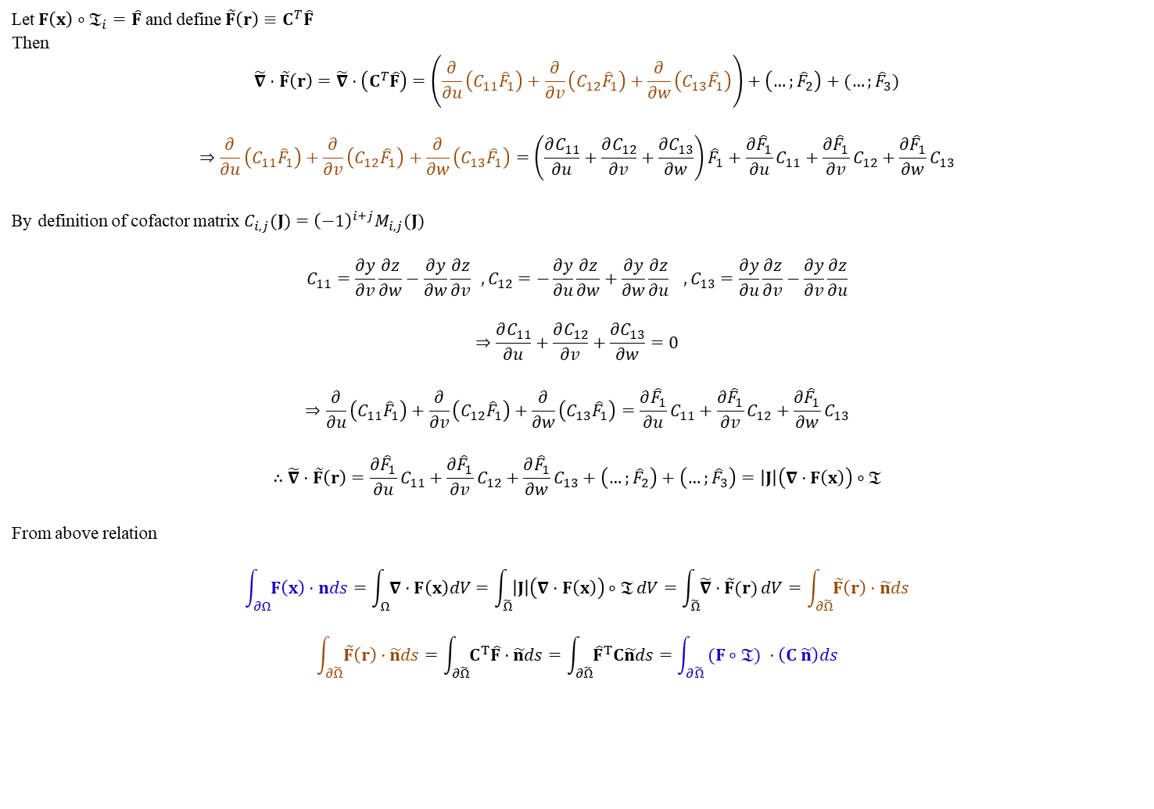
Appendix 2 Transformation of Surface Integral
Let$F\left(x\right)∘𝔗_{i}=\hat{F}$ and define $\tilde{F}\left(r\right)≡C^{T}\hat{F}$
Then
$$\tilde{∇}⋅\tilde{F}\left(r\right)=\tilde{∇}⋅\left(C^{T}\hat{F}\right)=\left(\frac{∂}{∂u}\left(C_{11}{\hat{F}}_{1}\right)+\frac{∂}{∂v}\left(C_{12}{\hat{F}}_{1}\right)+\frac{∂}{∂w}\left(C_{13}{\hat{F}}_{1}\right)\right)+\left(…;{\hat{F}}_{2}\right)+(…;{\hat{F}}_{3})$$
$$⇒\frac{∂}{∂u}\left(C_{11}{\hat{F}}_{1}\right)+\frac{∂}{∂v}\left(C_{12}{\hat{F}}_{1}\right)+\frac{∂}{∂w}\left(C_{13}{\hat{F}}_{1}\right)=\left(\frac{∂C_{11}}{∂u}+\frac{∂C_{12}}{∂v}+\frac{∂C_{13}}{∂w}\right){\hat{F}}_{1}+\frac{∂{\hat{F}}_{1}}{∂u}C_{11}+\frac{∂{\hat{F}}_{1}}{∂v}C_{12}+\frac{∂{\hat{F}}_{1}}{∂w}C_{13}$$
By definition of cofactor matrix $C_{i,j}(J)={\left(−1\right)}^{i+j}M_{i,j}(J)$
$$C_{11}=\frac{∂y}{∂v}\frac{∂z}{∂w}−\frac{∂y}{∂w}\frac{∂z}{∂v} ,C_{12}=−\frac{∂y}{∂u}\frac{∂z}{∂w}+\frac{∂y}{∂w}\frac{∂z}{∂u} ,C_{13}=\frac{∂y}{∂u}\frac{∂z}{∂v}−\frac{∂y}{∂v}\frac{∂z}{∂u}$$
$$⇒\frac{∂C_{11}}{∂u}+\frac{∂C_{12}}{∂v}+\frac{∂C_{13}}{∂w}=0$$
$$⇒\frac{∂}{∂u}\left(C_{11}{\hat{F}}_{1}\right)+\frac{∂}{∂v}\left(C_{12}{\hat{F}}_{1}\right)+\frac{∂}{∂w}\left(C_{13}{\hat{F}}_{1}\right)=\frac{∂{\hat{F}}_{1}}{∂u}C_{11}+\frac{∂{\hat{F}}_{1}}{∂v}C_{12}+\frac{∂{\hat{F}}_{1}}{∂w}C_{13}$$
$$∴\tilde{∇}⋅\tilde{F}\left(r\right)=\frac{∂{\hat{F}}_{1}}{∂u}C_{11}+\frac{∂{\hat{F}}_{1}}{∂v}C_{12}+\frac{∂{\hat{F}}_{1}}{∂w}C_{13}+\left(…;{\hat{F}}_{2}\right)+\left(…;{\hat{F}}_{3}\right)=\left|J\right|\left(∇⋅F\left(x\right)\right)∘𝔗$$
From above relation
$$\int_{∂Ω}{F\left(x\right)⋅nds}=\int_{Ω}{∇⋅F\left(x\right)dV}=\int_{\tilde{Ω}}{\left|J\right|\left(∇⋅F\left(x\right)\right)∘𝔗}dV=\int_{\tilde{Ω}}{\tilde{∇}⋅\tilde{F}(r)}dV=\int_{∂\tilde{Ω}}{\tilde{F}\left(r\right)⋅\tilde{n}ds}$$
$$\int_{∂\tilde{Ω}}{\tilde{F}\left(r\right)⋅\tilde{n}ds}=\int_{∂\tilde{Ω}}{C^{T}\hat{F}⋅\tilde{n}ds}=\int_{∂\tilde{Ω}}{{\hat{F}}^{T}C\tilde{n}ds}=\int_{∂\tilde{Ω}}{ (F∘𝔗) ⋅\left(C \tilde{n}\right)ds}$$

Slide 30















Appendix 2.1 Transformation of Surface Normal Vector
We consider surface normal vector $\tilde{n}$ in reference element $\tilde{Ω}$ which is tangent to the surface at $r$.
Then we assume there is a invertible transformation operator $𝔗_{i}$ which mapping from reference element $\tilde{Ω}$ to physical element $Ω$.
$$𝔗_{i}:r=\left(u,v,w\right)∈\tilde{Ω}↦x=\left(x,y,z\right)∈Ω_{ }$$
$$x=x(r)$$
Then we want to know surface normal vector $n$ in physical element which is tangent to the surface at $x$.
Unfortunately, it can’t be obtained by simple transformation
$$𝔗_{i}\left(\tilde{n}\right)≠n$$
To get surface normal vector $n$ in physical element, we use the fact that $n$ is tangent to the surface at $x$.
First we define infinitesimally small vector $∆r$ in $Ω_{i}$
$$∆r=r_{n}−r$$
$$η$$
$$\tilde{n}$$
$$y$$
$$∆r$$
$$Ω_{ }$$
$$n$$
$$r$$
$$r_{n}$$
$$𝔗_{i}$$
$$x$$
$$∆x$$
$$\tilde{Ω}$$
$$x_{n}$$
$$ξ$$
$$x$$

Slide 31

Appendix 2.1 Transformation of Surface Normal Vector
Since we assume infinitesimally small $∆r$ we can safely say
$$∆r⋅\tilde{n}=0$$
and
$$∆x≅J(r)∆r$$
From the fact that $n$ and $∆x$ must be orthogonal
$$∆x⋅n=\left(J\left(r\right)∆r\right)⋅n={\left(∆r\right)}^{T}J{\left(r\right)}^{T}n=0$$
To satisfy above relation
$$n={\left(J{\left(r\right)}^{T}\right)}^{−1}\tilde{n}$$
Normalize it
$$\frac{n}{\left\|n\right\|}=\frac{{\left(J{\left(r\right)}^{T}\right)}^{−1}\tilde{n}}{\left\|{\left(J{\left(r\right)}^{T}\right)}^{−1}\tilde{n}\right\|}=\frac{det(J){\left(J{\left(r\right)}^{T}\right)}^{−1}\tilde{n}}{det(J)\left\|{\left(J{\left(r\right)}^{T}\right)}^{−1}\tilde{n}\right\|}=\frac{C\tilde{n}}{\left\|C\tilde{n}\right\|}$$

